Slide 1
The Generalized Method of Cells
Michael Kaplan
Rehan Nawaz

Slide 2
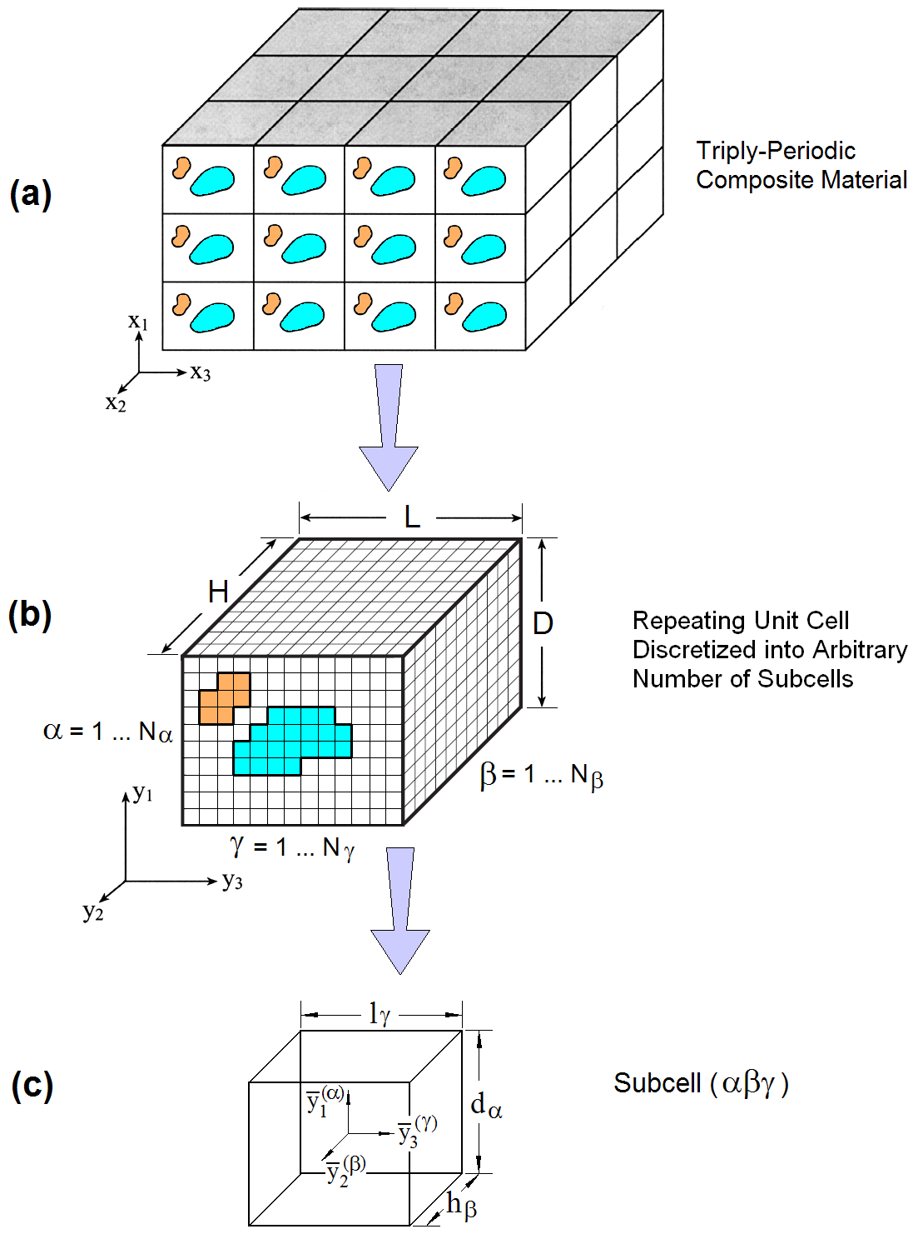
Background
Micromechanics at the constituent level is needed to model composites
Micromechanics takes into account the packing of the fibers
The generalized method of cells is an efficient way of modeling the micromechanics

Slide 3
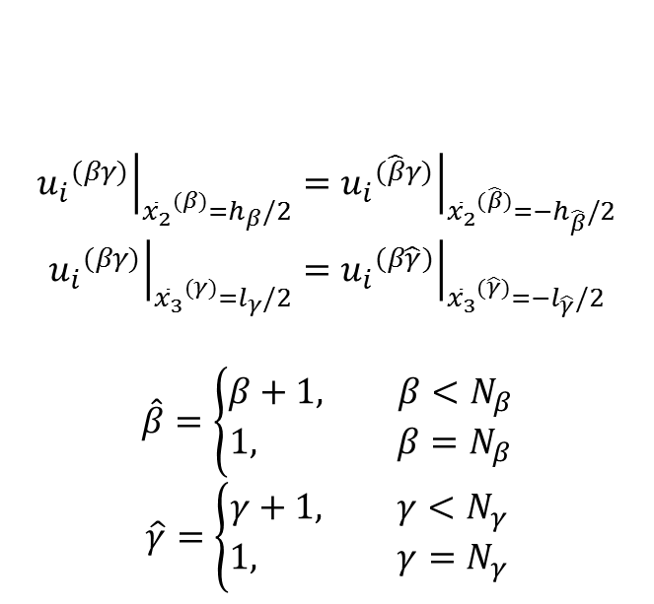
The Method of Cells
The RUC is partitioned into rectangular subcells
Many packing structures can be created
Boundary conditions are applied as an average across each subcell boundary
Periodic boundary conditions at the RUC boundaries
$${\left.{u_{i}}^{(βγ)}\right|}_{{{\overline{x}}_{2}}^{(β)}=h_{β}/2}={\left.{u_{i}}^{(\hat{β}γ)}\right|}_{{{\overline{x}}_{2}}^{(\hat{β})}={−h}_{\hat{β}}/2}$$
$${\left.{u_{i}}^{(βγ)}\right|}_{{{\overline{x}}_{3}}^{(γ)}=l_{γ}/2}={\left.{u_{i}}^{(β\hat{γ})}\right|}_{{{\overline{x}}_{3}}^{(\hat{γ})}={−l}_{\hat{γ}}/2}$$
$$\hat{β}=\left\{\begin{aligned}β+1, β<N_{β} \\ &1, β=N_{β}\end{aligned}\right.$$
$$\hat{γ}=\left\{\begin{aligned}γ+1, γ<N_{γ} \\ &1, γ=N_{γ}\end{aligned}\right.$$

Slide 4
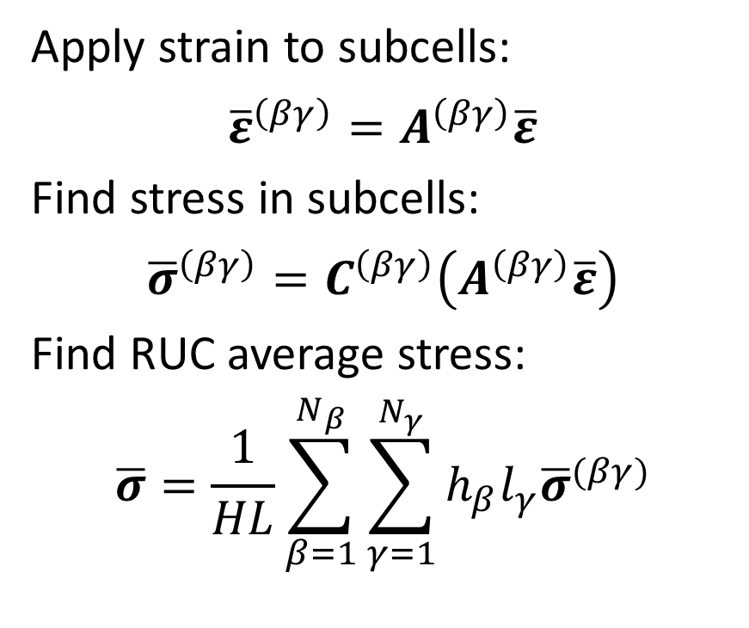
The Method of Cells
Apply strain to subcells:
$${\overline{ε}}^{\left(βγ\right)}=A^{\left(βγ\right)}\overline{ε}$$
Find stress in subcells:
$${\overline{σ}}^{\left(βγ\right)}=C^{\left(βγ\right)}\left(A^{\left(βγ\right)}\overline{ε}\right)$$
Find RUC average stress:
$$\overline{σ}=\frac{1}{HL}\sum_{β=1}^{N_{β}}{\sum_{γ=1}^{N_{γ}}{h_{β}l_{γ}{\overline{σ}}^{(βγ)}}}$$

Slide 5
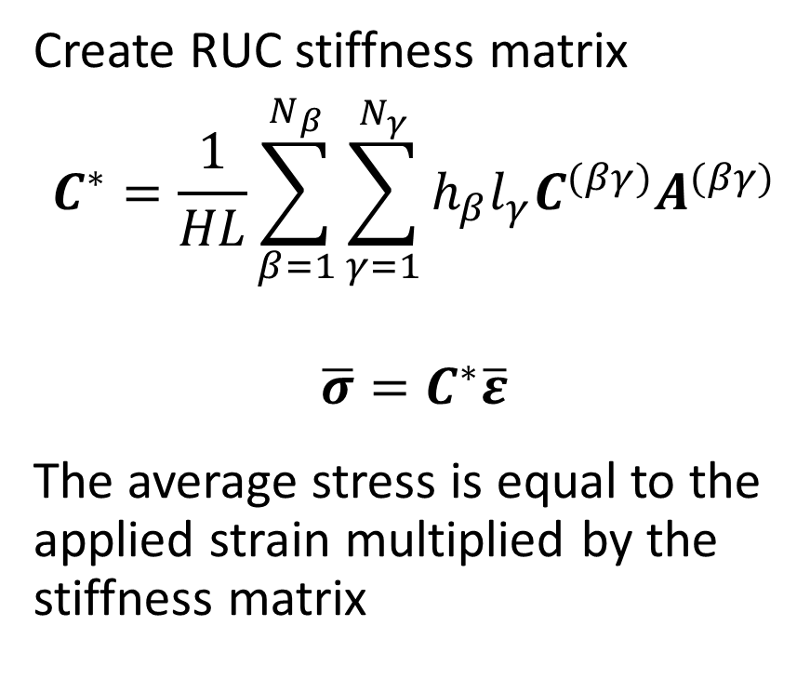
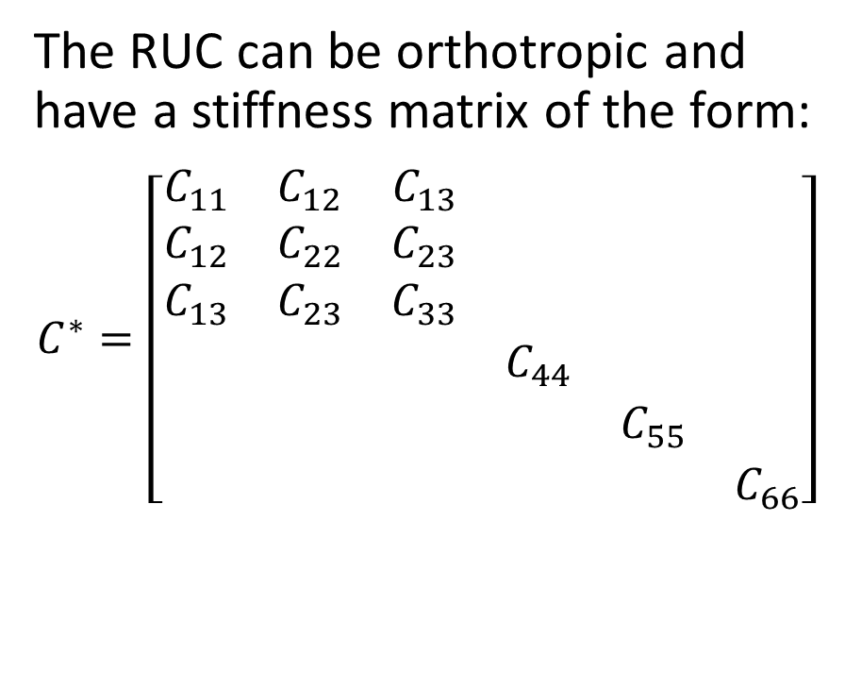
The Method of Cells
Create RUC stiffness matrix
$$C^{∗}=\frac{1}{HL}\sum_{β=1}^{N_{β}}{\sum_{γ=1}^{N_{γ}}{h_{β}l_{γ}C^{(βγ)}A^{(βγ)}}}$$
$$\overline{σ}=C^{∗}\overline{ε}$$
The average stress is equal to the applied strain multiplied by the stiffness matrix
The RUC can be orthotropic and have a stiffness matrix of the form:
$$C^{∗}=\left[\begin{matrix}\begin{matrix}C_{11} & C_{12} & C_{13} \\ C_{12} & C_{22} & C_{23} \\ C_{13} & C_{23} & C_{33}\end{matrix} & \begin{matrix} & & \\ & & \\ & & \end{matrix} \\ \begin{matrix} & & \\ & & \\ & & \end{matrix} & \begin{matrix}C_{44} & & \\ & C_{55} & \\ & & C_{66}\end{matrix}\end{matrix}\right]$$

Slide 6
The Code
% MOC Input: Hex_0.5_01_AS.moci
% Created: 11-Jul-2014 11:48:03
%
*CONSTITUENTS
NMATS=2
MAT=1,CMOD=1
EA=2.510e+05
ET=4.040e+04
NUA=0.256
NUT=0.321
GA=1.608e+04
GT=3.070e+04
%
MAT=2,CMOD=2
E=3.310e+03
NU=0.318
%
*CELL
AMOD=3
VF=0.500
DF=5.000e-03
%
*LOADING
LMOD=1
NL=1
L=0.00100,
%
*END
The code was written in MATLAB
Code reads an input file and outputs stress, strain, and the C-matrix
Material properties, cell architecture, and loading conditions are set in the input file
Materials are linear elastic and do not have failure conditions

Slide 7
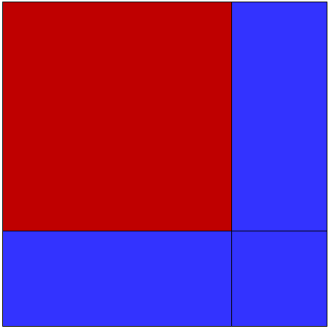
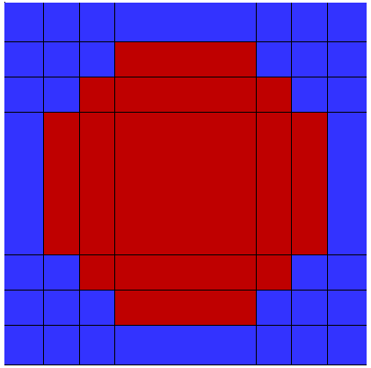
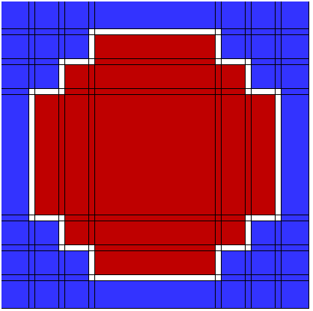
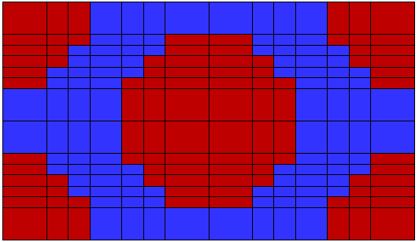
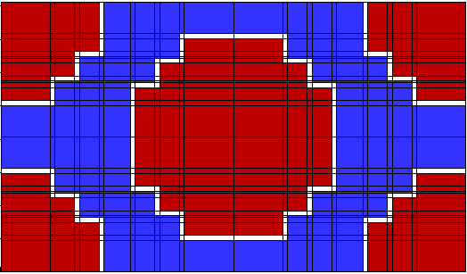
Predefined Architectures
Interphase
Variable volume fraction, fiber diameter, and interphase thickness
4-cell
Square
Hex

Slide 8
Error Approximation
The Composite Cylinder Model (CCM) is used to check the accuracy of the MOC code.
Property | CCM | 4-cell | Square | Hex |  | 4-cell | Square | Hex
E11 (GPa) | 127.16 | 124.29 | 124.29 | 124.20 |  | -2.26% | -2.26% | -2.33%
E22 (GPa) | 7.672 | 9.079 | 9.095 | 8.114 |  | 18.34% | 18.55% | 5.76%
G23 (GPa) | 2.795 | 3.473 | 3.456 | 2.949 |  | 24.26% | 23.65% | 5.51%
G12 (GPa) | 3.401 | 3.257 | 3.379 | 3.037 |  | -4.23% | -0.65% | -10.70%
ν23 | 0.3725 | 0.3071 | 0.3157 | 0.3759 |  | -17.56% | -15.25% | 0.91%
Ν12 | 0.3197 | 0.3197 | 0.3197 | 0.3196 |  | 0.00% | 0.00% | -0.03%
K23 (GPa) | 6.236 | 6.696 | 6.794 | 6.643 |  | 7.38% | 8.95% | 6.53%
Transversely isotropic relations were used to find the properties. Some RUCs are not transversely isotropic, so we are working on a better way of finding the properties.

Slide 9
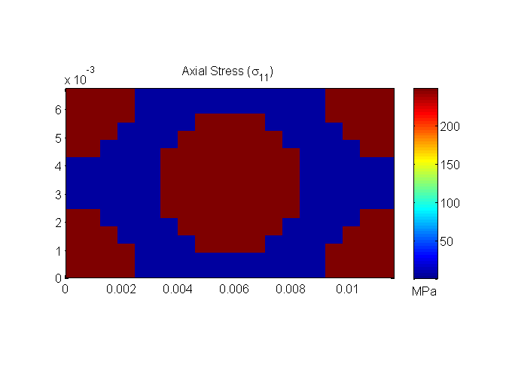
Test Case: Cell Biasing
The code was tested to make sure that the results were not dependent upon the number of cells.
We made the Interphase the same material as the Interphase and got the same results.
No Interphase cells present
 | Hex Pack | Hex Pack with Interphase (Same properties as matrix)
E11 (GPa) | 124.20 | 124.20
v12 | 0.3196 | 0.3196
G12 (GPa) | 3.03 | 3.03
K23 (GPa) | 6.64 | 6.64
G23 (GPa) | 2.94 | 2.94
E22 (GPa) | 8.11 | 8.11
v23 | 0.3759 | 0.3759
Interphase cells present

Slide 10

Test Case: Interphase Effects
The interphase stiffness was changed to see its effect on the RUC stiffness
Interphase thickness of 2% of the fiber radius was used
Hex Pack with Interphase (0.33 GPa)
 | Hex Pack | Hex Pack with Interphase (0.33 GPa) | Hex pack with interphase (100 GPa)
E11 (GPa) | 124.20 | 124.16 | 126.64
v12 | 0.3196 | 0.3196 | 0.3196
G12 (GPa) | 3.03 | 2.18 | 3.22
K23 (GPa) | 6.64 | 4.87 | 6.96
G23 (GPa) | 2.94 | 2.28 | 3.12
E22 (GPa) | 8.11 | 6.18 | 8.57
v23 | 0.3759 | 0.3549 | 0.3705
Hex Pack with Interphase (100 GPa)

Slide 11
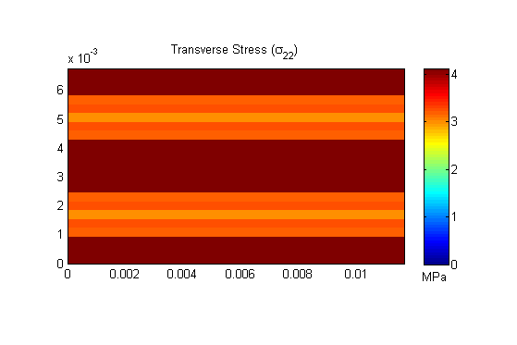
Test Case: Transverse Strain
Strain the RUC in the X₂ direction
x3
x2

Slide 12
Fortran Code

Slide 13
Why Fortran?
We simplified the Matlab code so that it could be used with Fortran
Faster processing
Compiling
Ability to work with Abaqus

Slide 14
Limitations
Only two materials are currently possible
Transversely isotropic fiber
Isotropic matrix
No Matlab plots
No built in architectures, they must be user defined
The stiffness matrix is the only output

Slide 15
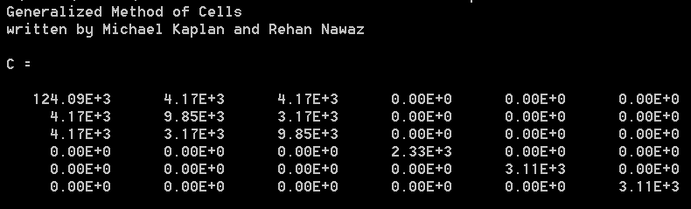
How it works
Run the function with input in the command prompt
The function will output the stiffness matrix

Slide 16
Further Work
Inelastic materials
Subcell failure integration
Abaqus integration
Inexact boundary conditions

Slide 17
Questions?

